Slide 1

Classification Logistic Regression
Ahmed Metawaa

Slide 2

Agenda:
A Quick Revision of Linear Regression
What is the meaning of classification?
Types of Classification..
Logistic Regression
Confusion Matrix

Slide 3

A Quick Revision of Linear Regression

Slide 4
Regression models are used for predicting a real value, like salary and temperature for example.
Linear regression is used to predict the value of a variable based on the value of another variable.

Slide 5
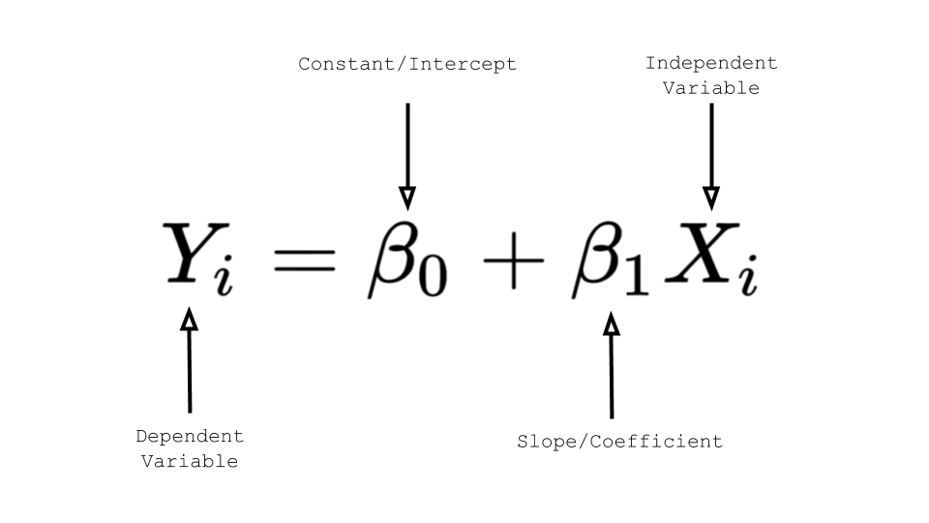

Slide 6
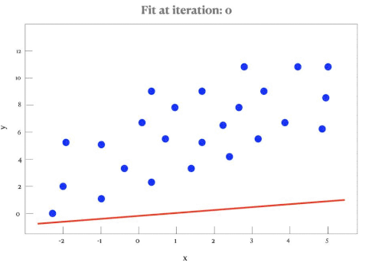

Slide 7

What is the meaning of classification?

Slide 8
It is a type of Supervised Learning
Classification is the division of data into several sections
Classification is based on similarity

Slide 9
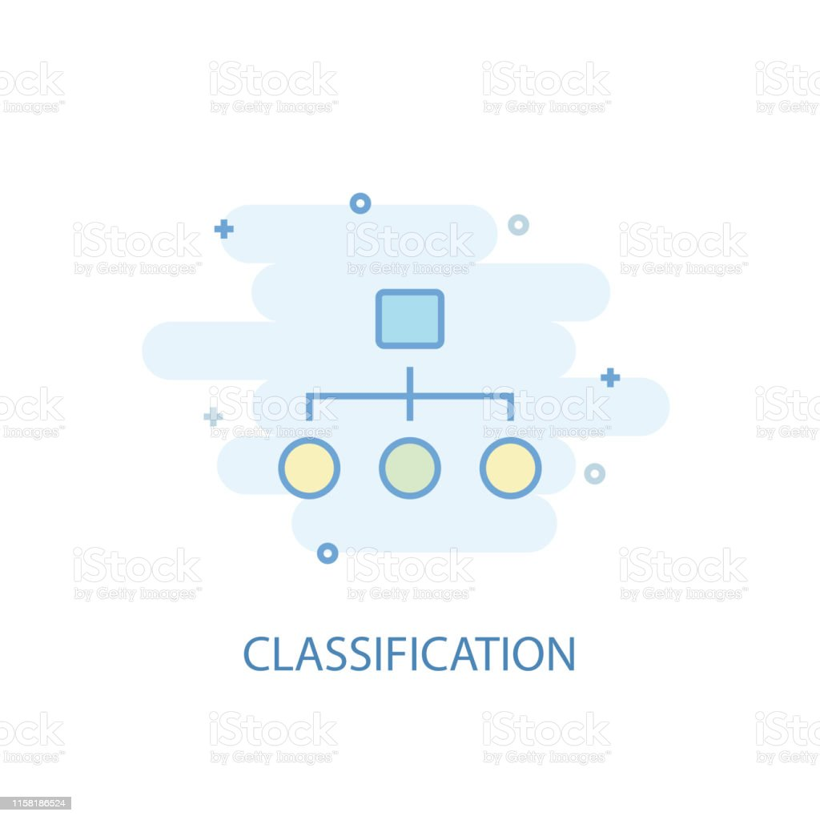
Types of Classification..

Slide 10

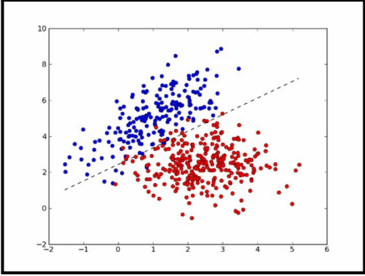
Binary Classification

Slide 11
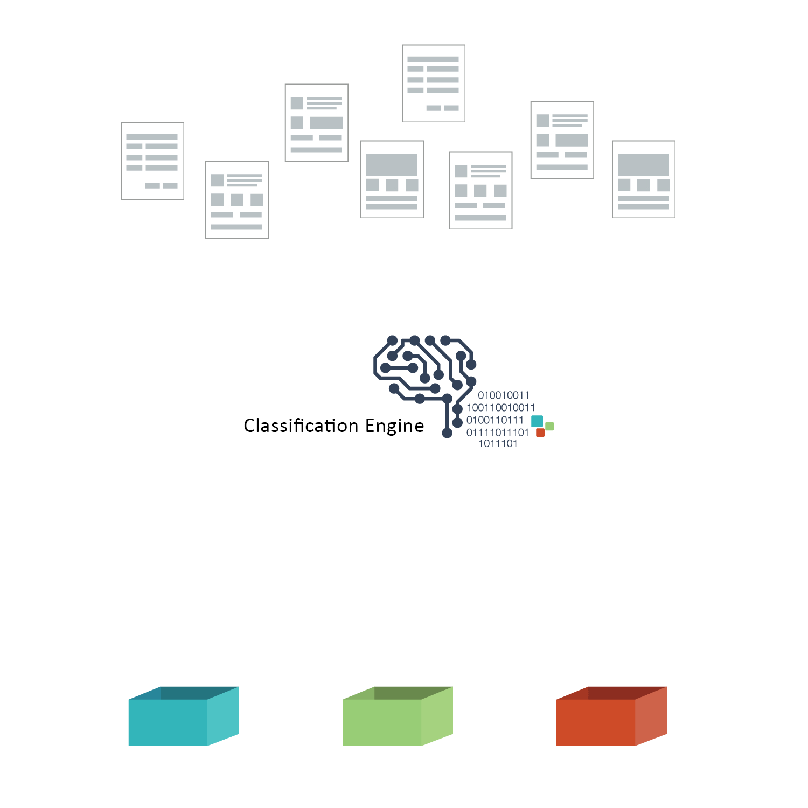
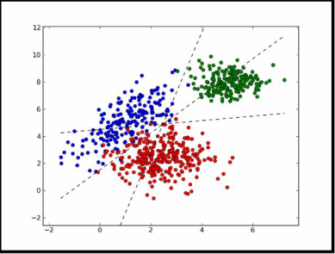
Multiple Classification

Slide 12
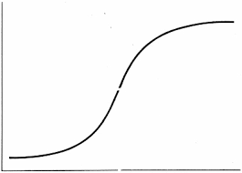
Logistic Regression

Slide 13
Logistic Regression model
Is a widely used statistical model which is primarily used for classification purposes.
Helps us to classify these observations into two or more discrete classes.

Slide 14
The Logistic Regression algorithm works as follows - - -
Implement linear equation
Sigmoid Function
Decision boundary
Making predictions

Slide 15
The Logistic Regression algorithm works as follows - - -
Implement linear equation
Sigmoid Function
Decision boundary
Making predictions

Slide 16
Implement linear equation
Logistic Regression works by implementing a linear equation with independent variables to predict a target value.

Slide 17
Implement linear equation
For example, we consider the number of hours studied “independent variable” denoted by x1,
Probability of passing the exam “target variable” denoted by z.
Then the linear equation would be:
z = w.x1 + b
Here, the coefficients w and b are the parameters of the model.
So, the predicted response value is given by the above equations

Slide 18
The Logistic Regression algorithm works as follows - - -
Implement linear equation
Sigmoid Function
Decision boundary
Making predictions

Slide 19
Sigmoid Function
This predicted response value “z” converted into a probability value that lie between 0 and 1.
In machine learning, we use the sigmoid function to map predicted values to probability values.
The sigmoid function has an S shaped curve. It is also called sigmoid curve.

Slide 20


Slide 21
The Logistic Regression algorithm works as follows - - -
Implement linear equation
Sigmoid Function
Decision boundary
Making predictions

Slide 22
Decision boundary
This probability value is then mapped to a discrete class which is either “0” or “1”.
To do that we select a threshold value which is called Decision boundary.
Above this threshold map the probability values into class 1.
Below which we will map values into class 0.
Mathematically, it can be expressed as follows:-
P ≥ 0.5 => class 1
P < 0.5 => class 0

Slide 23
Decision boundary
Generally, the decision boundary is set to “0.5” So,
if the probability value is 0.8 (> 0.5), we will map this observation to class….?
if the probability value is 0.2 (< 0.5), we will map this observation to class ….?

Slide 24
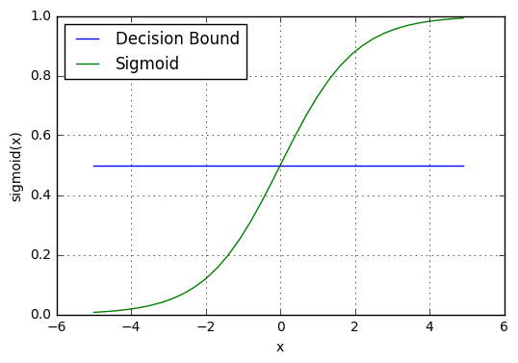

Slide 25
The Logistic Regression algorithm works as follows - - -
Implement linear equation
Sigmoid Function
Decision boundary
Making predictions

Slide 26
Making predictions
Now, we know about sigmoid function and decision boundary in logistic regression. So we can use these to write a prediction function.
A prediction function returns the probability of the observation being positive “Yes or True” we call this as class “1” if the probability closer to 1, otherwise class 0.

Slide 27

Confusion Matrix

Slide 28
Confusion matrix
Is a tool for summarizing the performance of a classification algorithm.
Four types of outcomes are possible.

Slide 29
The four outcomes

Slide 30
True Positives (TP)
occur when we predict an observation belongs to a certain class and the observation actually belongs to that class.

Slide 31
True Negatives (TN)
occur when we predict an observation does not belong to a certain class and the observation actually does not belong to that class.

Slide 32
False Positives (FP)
occur when we predict an observation belongs to a certain class but the observation actually does not belong to that class.

Slide 33
False Negatives (FN)
occur when we predict an observation does not belong to a certain class but the observation actually belongs to that class.

Slide 34
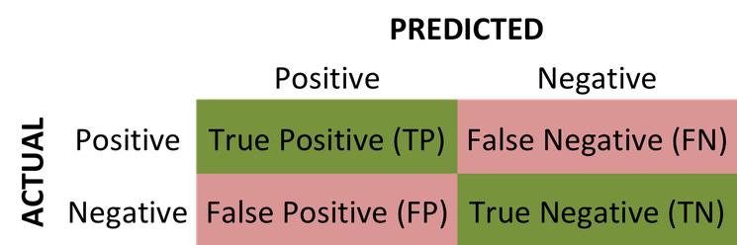

Slide 35
Precision
The accuracy of the positive predictions
e.g. YouTube videos for kids
Recall
Ratio of positive instances that are correctly detected by the classifier
e.g. catch thieves

Slide 36
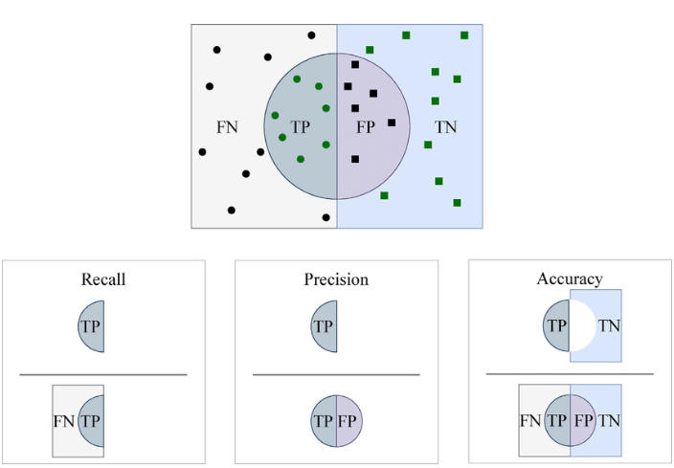

Slide 37
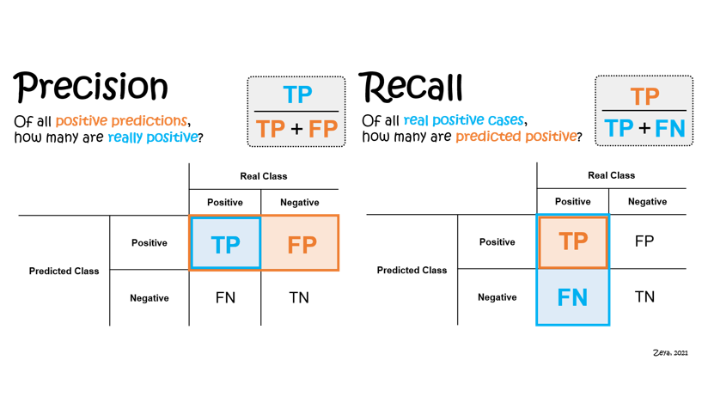

Slide 38


Slide 39


